Slide 1

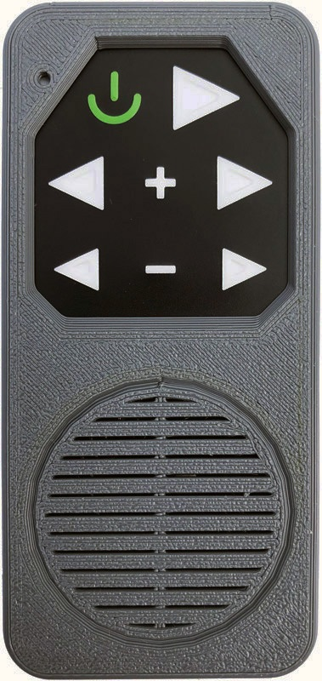

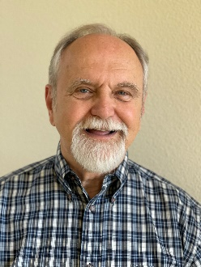
The Parable of the Sower & the Seed…
Matthew 13:3-9
“He who has ears to hear, let him hear”
David Lind – Presenter
N.E.T. Event
Tuesday, August 9, 2022

Slide 2
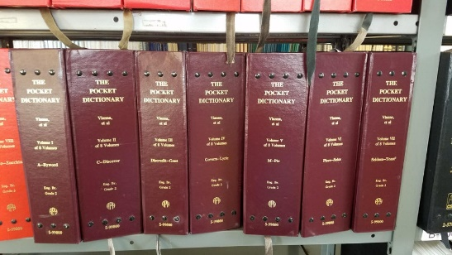
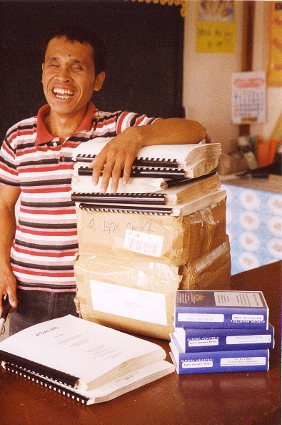
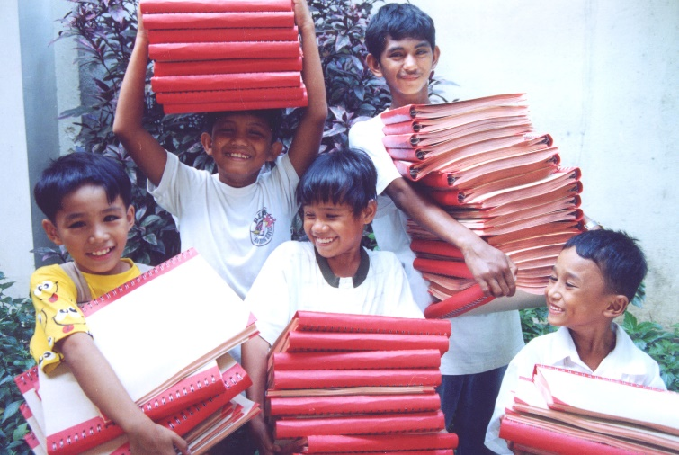

A Brief History
Created for the blind, by the son of a blind missionary who served in the Philippine Islands.
Globally, blind individuals make up more than 36 million people. Even with a Braille Bible, many blind individuals cannot read Braille, and many blind individuals (as well as an estimated ½ of sighted individuals) are oral learners.

Slide 3
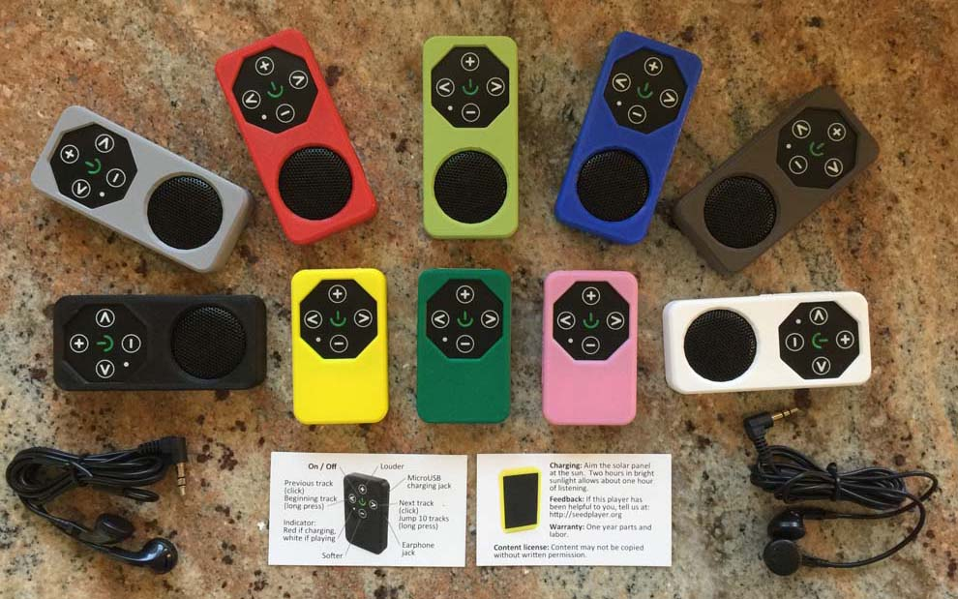
Solution: Solar-Powered Audio Bible
• Low cost (sub $10)
• Solar-powered
• 3D printed
• Multiple color choices
• Simple multilevel navigation
• MicroSD-based using MP3 audio files
• Potential franchising for in-country production

Slide 4
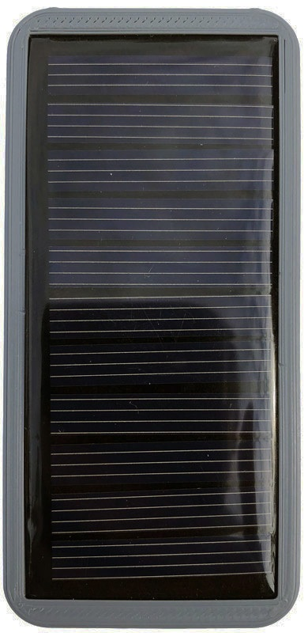
What it is; & What it doesn’t need…
It is a Solar-Powered Audio Bible - a standalone device that needs only sunlight and…
does NOT require:
  Computers
  Smart Phones
  TV’s & DVD players
  Internet or WiFi or Bluetooth
  Electricity
  Sight
  Literacy

Slide 5

Multilevel Navigation
Εach SeedPlayer is a “Bookcase” & within it are contained the following:
• Bookshelf // press = jump
(NT, OT, Music, Sermons… )
• Book // press = jump (long press = jump 10)
(Matthew, Mark, Luke, John… )
• Chapters // press = jump (long press = jump 10)
(1, 2, 3, … )
• Verses // long press plus “+” = fast forward three minutes
long press minus “-” = rewind one minute
[ normal 1 second press = volume louder or softer ]

Slide 6

Ministries Served
• Remote areas
• Homeless
• Prisoners
• Children
• Elderly
• Blind
• Street evangelism
• Women’s shelters
• Soldiers & other military
• Vacation Bible School
• Others...

Slide 7
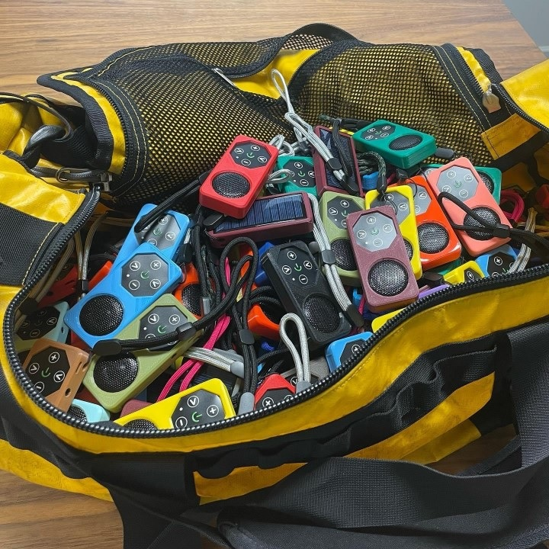
Content
• Bibles & Testaments
• Outreach Materials
• Testimonies
• Teaching / Training
• Discipleship Training
• Worship Music
• Seminars & Conferences

Slide 8
Engage with us…
• Introduce SeedPlayer to others
• Assist with regional production — start a franchise in India, Uganda, Nigeria, Ethiopia or anywhere that you minister
• Sponsor distribution projects, like DVBS, Missions Trips, etc.
• Help secure additional audio Biblical content
• Help develop a clear shell for SeedPlayer for prison ministries
• Volunteer — what are your skills or passions?
• Give time &/or resources as God blesses you
Getting the Gospel of Jesus Christ out
Far and Wide … and Fast!

Slide 9
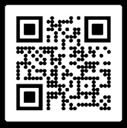
Questions?
Start a Project?
Who to contact…
Need more info? Please contact
www.SeedPlayer.org
David Lind in Portland, OR
703-408-5910
David@SeedPlayer.org
& / or
Joel Lown in Knoxville, TN
865-403-9006
Joel@SeedPlayer.org

